Slide 1

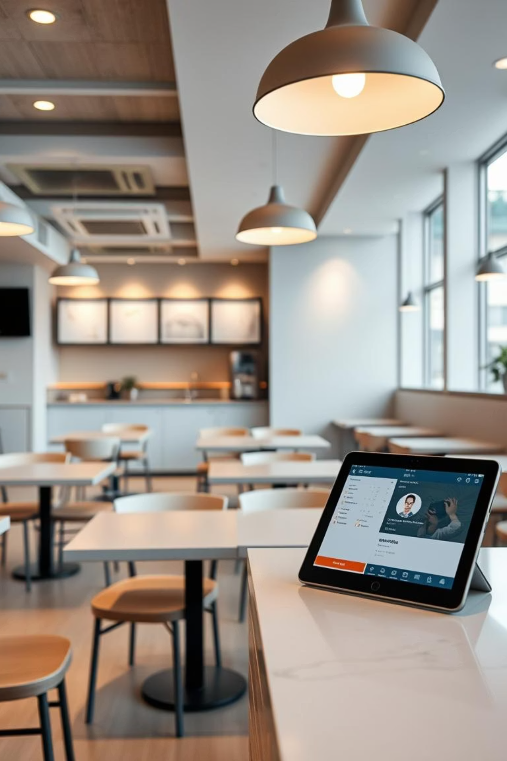
DineEase: Smart Restaurant Ordering System
Revolutionizing the restaurant experience through technology

Slide 2




Meet Our Team
Rabina Akhter
ID: 221-15-5506
Marjan Dina
ID: 221-15-5218
Kanij Fatema
ID: 221-15-4884
Nur Mohammad Hridoy
ID: 221-15-5952

Slide 3
Presentation Overview
1
2
Introduction & Purpose
Product Overview
Project scope and goals
Key features and target users
3
4
Engineering Requirements
Web Project Management
System functionalities and constraints
Phases, planning, and execution

Slide 4
DineEase: Project Introduction
A web-based system designed to streamline restaurant operations and customer ordering.
Project Name
Core Purpose
DineEase – Smart Restaurant Ordering System
Enhance the dining experience:
Project Type
Seamless online ordering for customers
Efficient order and menu management for admins
Web-based food ordering and restaurant management system.

Slide 5
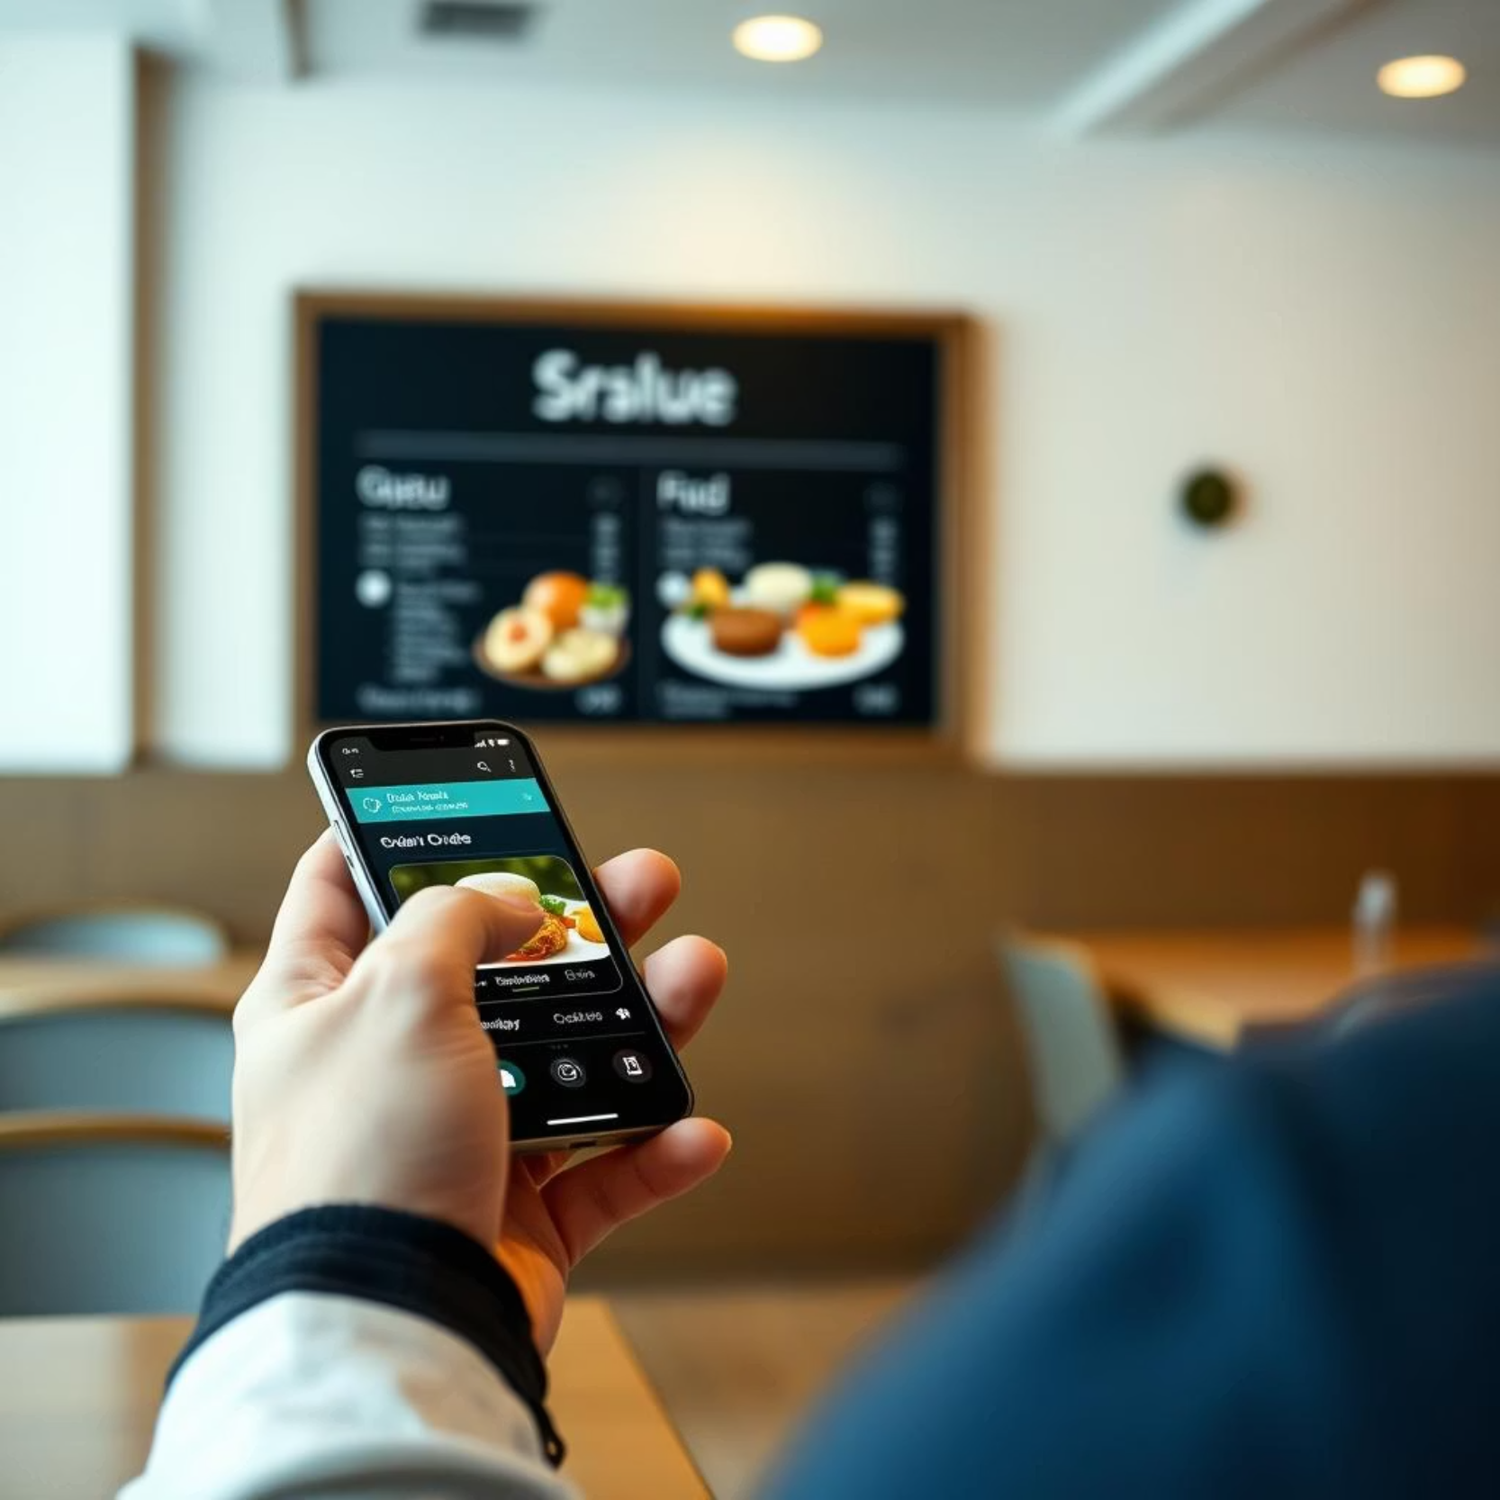
Product Overview
Product Perspective
DineEase is a standalone web application featuring:
Customer-facing interface
Admin management dashboard
Goal: Reduce manual tasks, waiting times, and administrative workload.

Slide 6


Target Users & Key Functions
Target Users
Product Functions
User registration/login
Customers
Menu browsing & filtering
Order and pay online
Add to cart & checkout
Track delivery status
Payment simulation
Order status tracking
Admins
Admin dashboard: order, menu, user management
Manage orders and menus
Handle customer inquiries

Slide 7





Core Product Functions
User Management
Menu Interaction
Order Processing
Registration and login functionalities.
Browsing and filtering menu items.
Add to cart, checkout, payment simulation.
Order Tracking
Admin Dashboard
Real-time order status updates.
Comprehensive management of orders, menus, and users.

Slide 8
Engineering Requirements
Defining what the system must do, not how it does it.
What the System Does
Operational Constraints
Services and functionalities provided to users.
Limitations and boundaries within which the system operates.
Requirements Engineering (RE): A systematic process of discovery, analysis, documentation, and verification of these system requirements.

Slide 9



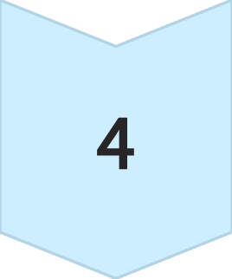
Web Project Management: DineEase
Structured approach to planning and executing web development.
Requirement Analysis
Gathering user feedback via Google Forms for validation.
Task Planning & Scheduling
Weekly tasks and deliverables are defined with a Gantt chart.
Design & Diagrams
Wireframes and UX visualization for early issue detection.
Development & Version Control
Incremental coding with local file management.

Slide 10
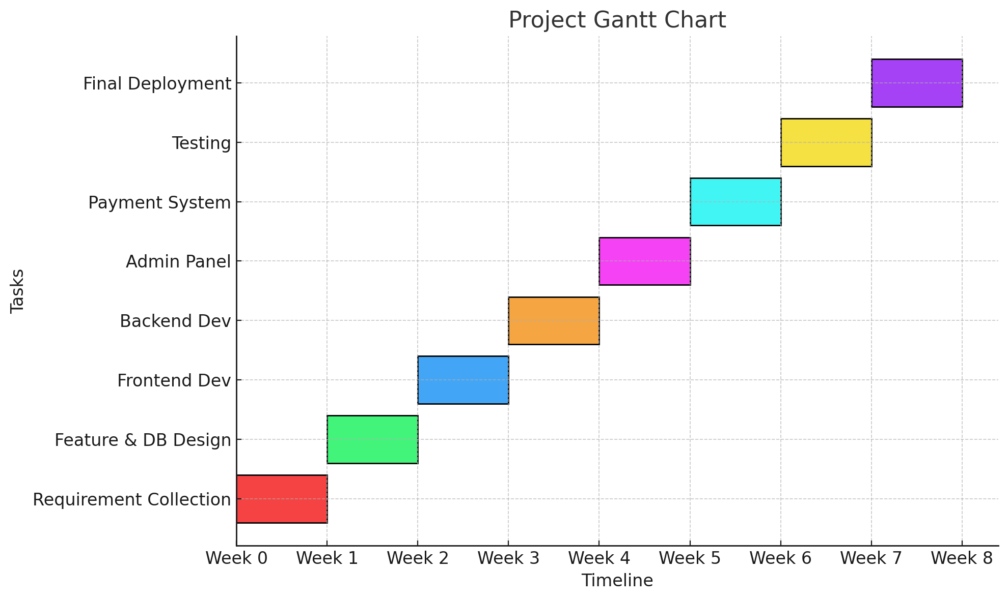
Gantt Chart

Slide 11
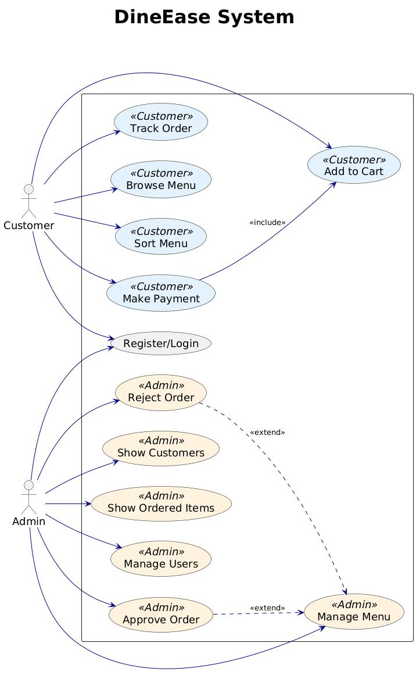
Design Diagrams: Use Cases
Visualizing user interactions and system functions.
The Use Case Diagram provides a high-level view of how users (Customer, Admin) interact with the DineEase system and its main functionalities, such as managing orders, browsing menus, and making payments.

Slide 12
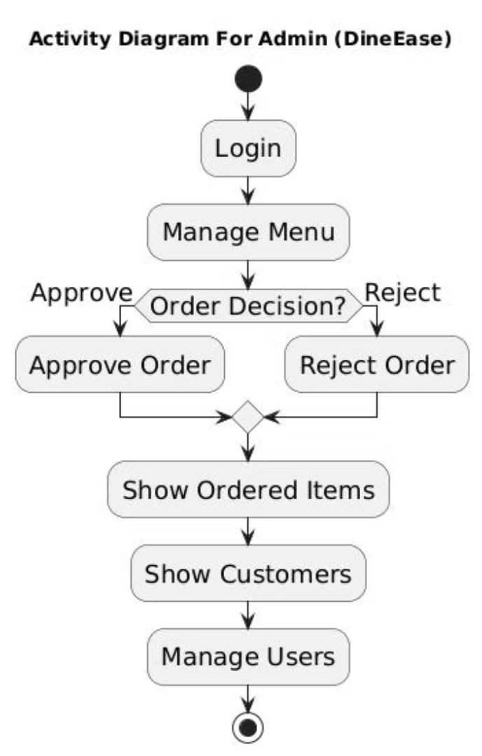
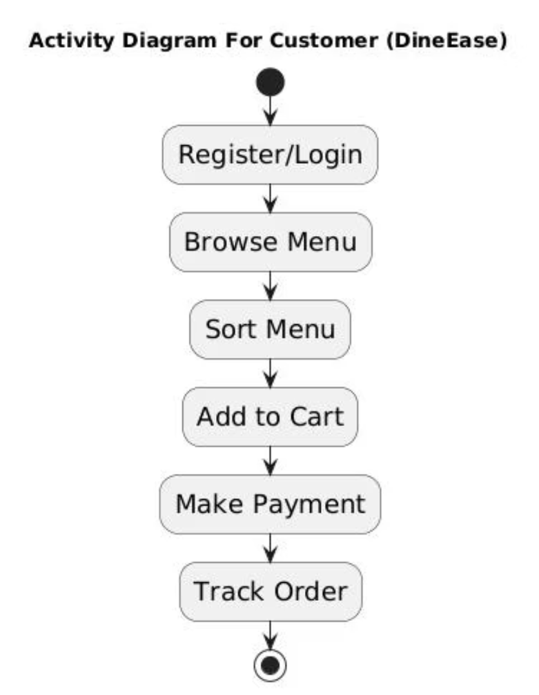
Design Diagrams: Activity
Detailed flow of operations and interactions.
Admin Activity
User Activity
Activity diagrams map the sequential steps and decisions within specific processes for both administrators and customers. The Sequence Diagram below details the interaction flow between different system components during an operation.

Slide 13
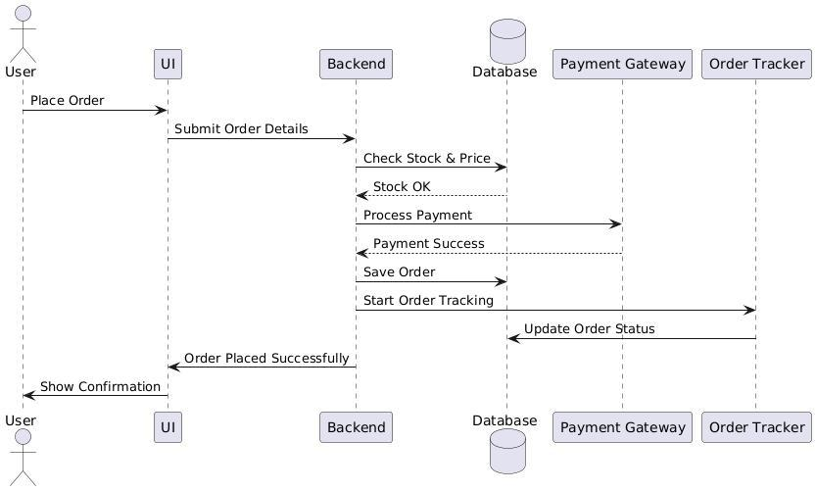
Design Diagrams: Sequence

Slide 14
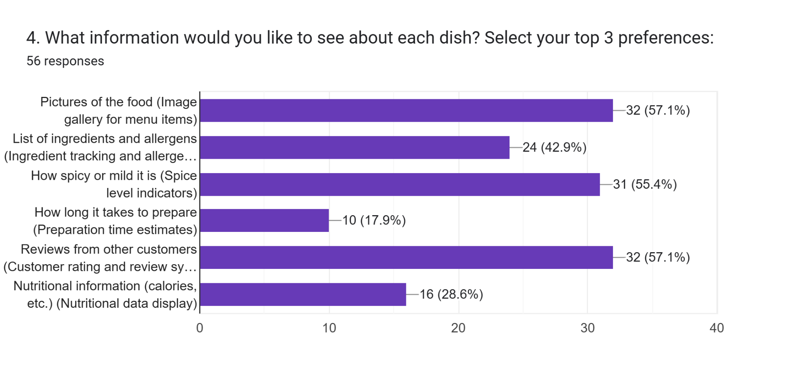
User Requirements Analysis

Slide 15
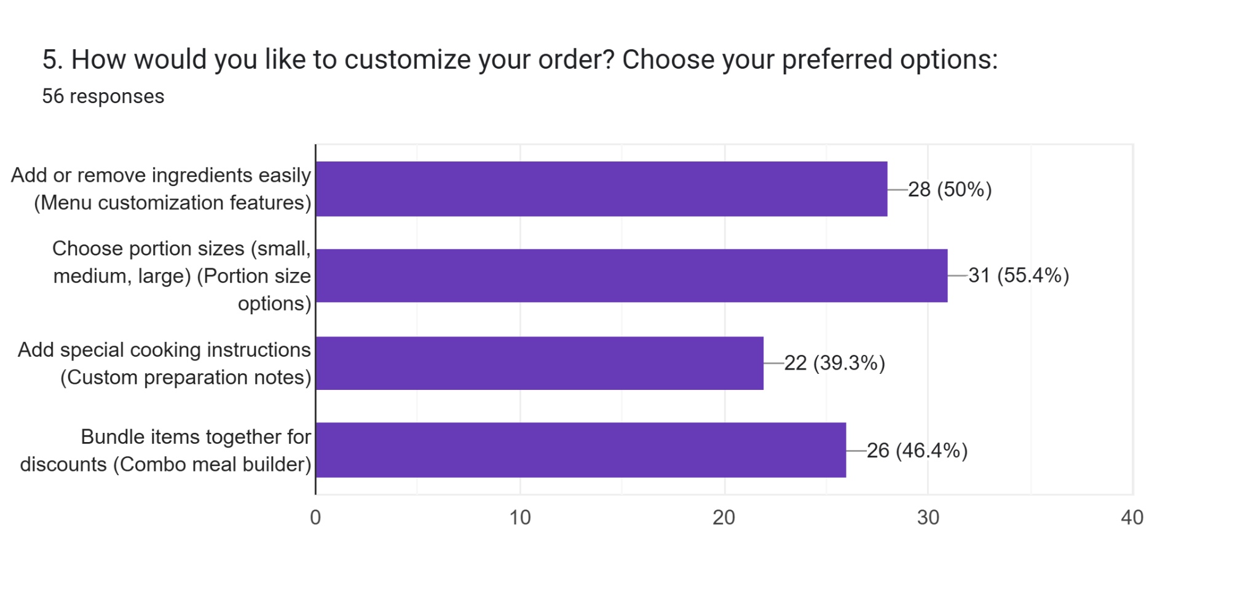
User Requirements Analysis

Slide 16
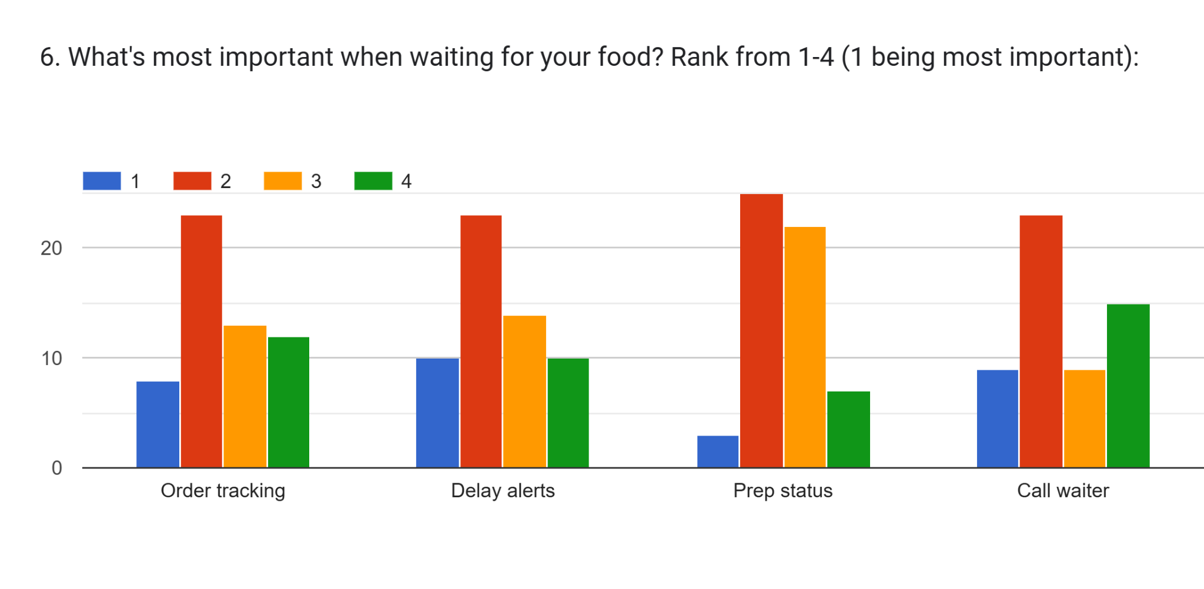
User Requirements Analysis

Slide 17
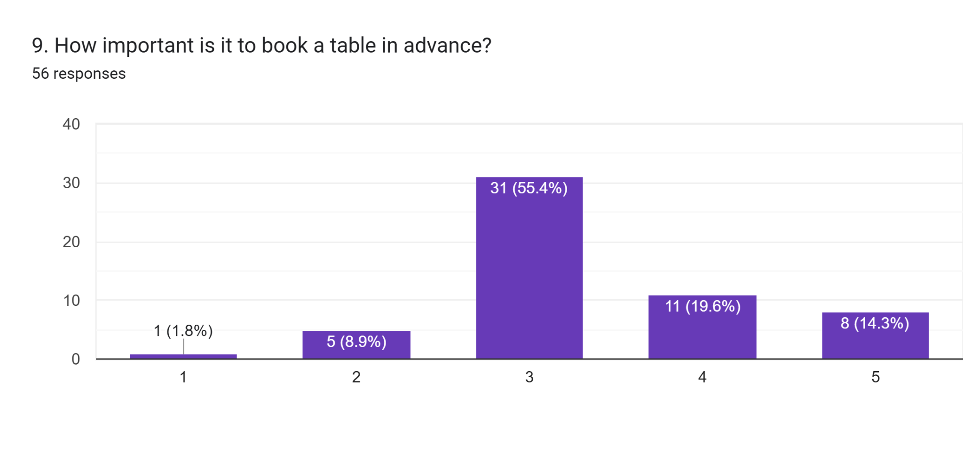
User Requirements Analysis

Slide 18
Key Takeaways & Next Steps
User-Centric Design
Structured Development
Continuous Improvement
Prioritizing user feedback for product evolution.
Phased approach ensures quality and efficiency.
Future iterations based on ongoing feedback and performance.
DineEase is poised for success, with a clear roadmap for continued growth and enhancement.

Slide 19
THANK YOU

